Slide 1

Red Hat System Administration I 10.0
Chapter 6
Dilara Gülenç

Slide 2
The Linux File-System Hierarchy
Single Inverted Tree Structure: All Linux files reside within a unified hierarchy starting at the root directory (/), with subdirectories branching downward.
The Forward Slash (/):
  Represents the primary root directory when placed at the beginning of a path.
  Serves as the standard directory separator between nested folders and files (e.g., /etc/issue).
Standardization: Subdirectories under / are organized by specific content types and operational roles to ensure predictable system administration.
Static Content: Unchanged without explicit administrative modification or software upgrades (e.g., binaries, libraries).
Dynamic / Variable Content: Modified or continuously appended by active system processes (e.g., log files, spoolers).
Persistent Content: Retained across system reboots (e.g., configuration files in /etc).
Runtime Content: Ephemeral data generated by running processes; automatically recreated or cleared on reboot (e.g., /run).

Slide 3
Significant Red Hat Enterprise Linux Directories
Location | Purpose
/boot | Files to start the boot process.
/dev | Special device files that the system uses to access hardware.
/etc | System-specific configuration files.
/home | Home directory, where regular users store their data and configuration files.
/root | Home directory for the administrative superuser, root.
/run | Runtime data for processes that started since the last boot. This data includes process ID files and lock files. The contents of this directory are re-created on reboot. This directory consolidates the /var/run and /var/lock directories from earlier versions of Red Hat Enterprise Linux.
/tmp | A world-writable space for temporary files. Files that are not accessed, changed, or modified for 10 days are deleted from this directory automatically. The /var/tmp directory is also a temporary directory, in which files that are not accessed, changed, or modified in more than 30 days are deleted automatically.
/usr | Installed software, shared libraries, including files, and read-only program data. Significant subdirectories in the /usr directory include the following commands: /usr/bin: User commands /usr/sbin: System administration commands /usr/local: Locally customized software
/var | System-specific variable data should persist between boots. Files that dynamically change, such as databases, cache directories, log files, printer-spooled documents, and website content, might be found under the /var directory.

Slide 4
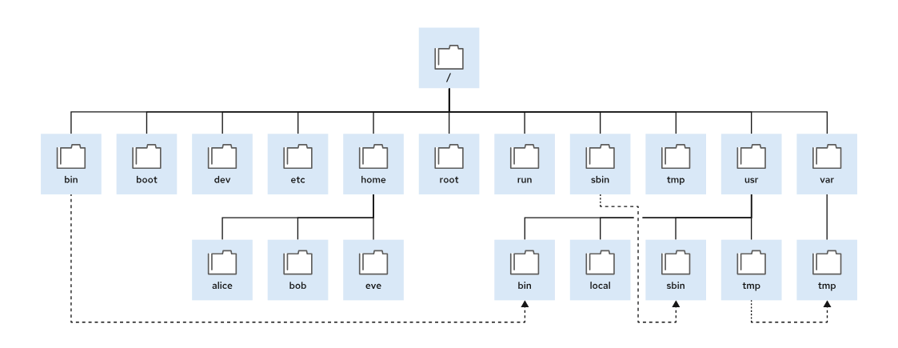
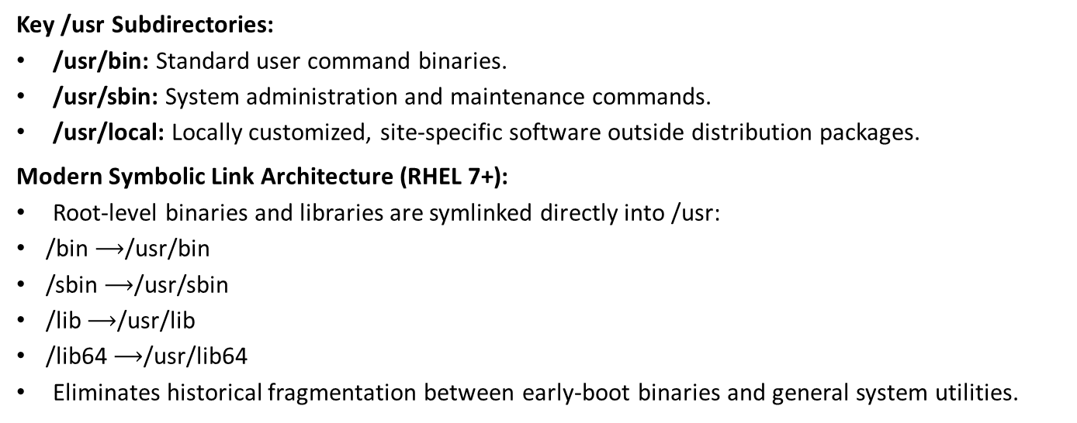
The /usr Directory & Modern Symlink Consolidation
Key /usr Subdirectories:
  /usr/bin: Standard user command binaries.
  /usr/sbin: System administration and maintenance commands.
  /usr/local: Locally customized, site-specific software outside distribution packages.
Modern Symbolic Link Architecture (RHEL 7+):
  Root-level binaries and libraries are symlinked directly into /usr:
    /bin $⟶$/usr/bin
    /sbin $⟶$/usr/sbin
    /lib $⟶$/usr/lib
    /lib64 $⟶$/usr/lib64
  Eliminates historical fragmentation between early-boot binaries and general system utilities.

Slide 5
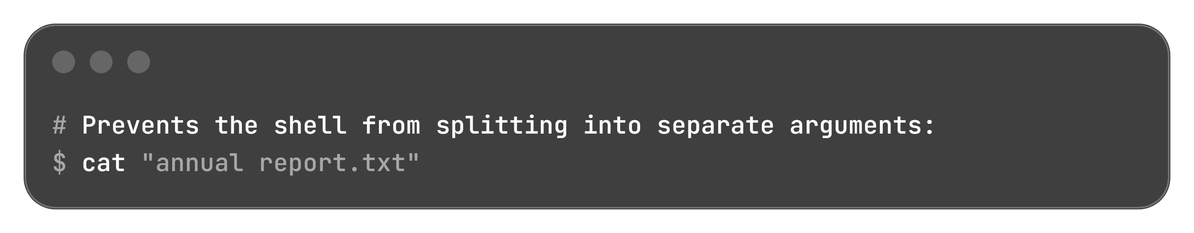
Specifying Files by Name: Path Resolution Fundamentals
Location Path: Specifies the unique file-system location of a target file or folder.
Traversal Mechanics: Traverses nested subdirectories delimited by a forward slash (/) until the final target is reached.
Unified Object Model: Directories (folders) are referenced using the exact same path syntax as standard files.
Initial Working Context: Shell sessions initialize by default inside the user's home directory (/home/username or /root).
Shell Parsing Behavior: Bash treats whitespace (spaces and tabs) as delimiters between command options and arguments.
Handling Spaces in Names:
  If a file name contains spaces, wrap it in double or single quotation marks:
Best Practice: Avoid spaces in Linux file names entirely (prefer hyphens or underscores).

Slide 6
Absolute Paths vs. Relative Paths
RELATIVE PATHS
Definition: Specifies only the path segments needed to reach the destination from the shell's current working directory.
Recognition Rule: Begins with any character other than /.
Contextual Example (Assuming Current Directory is /var):
  Absolute Target: /var/log/messages
  Relative Reference: log/messages
Local Reference: Omitting all slashes refers directly to a file residing inside the current working directory (e.g., messages while in /var/log).
ABSOLUTE PATHS
Definition: A fully qualified path defining the exact, unambiguous location of a file within the entire hierarchy.
Starting Anchor: Always originates at the root (/) directory.
Recognition Rule: Starts with a forward slash (/) as the very first character.
Example:
  Primary system message log: /var/log/messages

Slide 7
Case Sensitivity & File System Behaviors
File System Type | File System Implementations | Naming Behavior & Case Handling | Collision Outcome (file.txt vs. File.txt)
Native Linux | XFS, ext4 | Case-Sensitive: Exact character casing determines unique directory entries | Two distinct, independent files created side by side
Non-Linux / External | VFAT, NTFS, HFS+ / APFS (default) | Case-Preserving: Retains original casing display, but does not distinguish case for lookups | Single file: Second file overwrites or collides with the first
Administrative Key Takeaway: Linux treat files like MyExample.txt and myexample.txt as completely distinct files within the same directory; verify capitalization accurately when scripting paths.

Slide 8
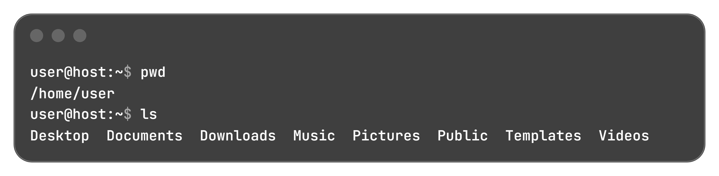
Directory Inspection & Prompt Indicators (pwd, ls)
Home Directory (~): The tilde character represents the user's home folder.
  In home directory: prompt displays ~
  In a home subdirectory: prompt displays relative path (e.g., ~/Videos)
Outside Home: Prompt displays the full absolute path (e.g., /var/log).
Direct Path Target: Tilde expansion works directly in argument paths (e.g., ls -l ~ queries home from anywhere).
pwd (Print Working Directory): Outputs the full absolute path of the shell's active working directory.
ls (List): Lists contents of a target directory (defaults to current working directory when omitted):

Slide 9
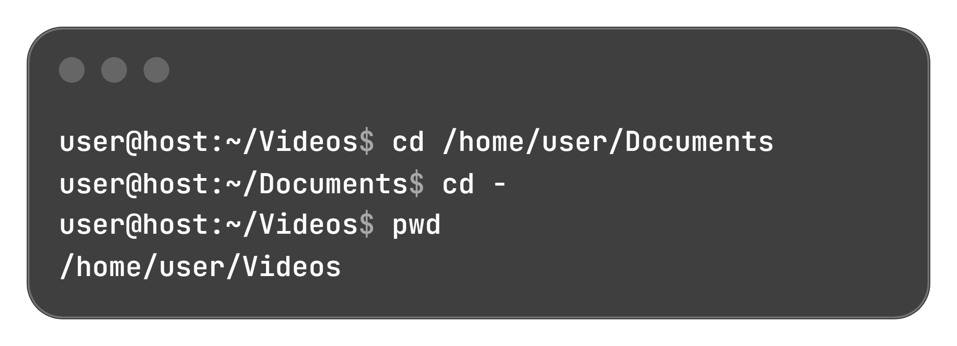
Directory Traversal with the cd Command
Command | Target Destination | Traversal Behavior
cd (bare) | Home directory (~) | Returns to /home/username from any system location
cd <path> | Specified directory | Navigates using either relative (cd Videos) or absolute (cd /var/log) paths
cd - | Previous working directory | Toggles between the current and immediately prior working directory
cd .. | Parent directory | Moves up one level in the file-system hierarchy
cd . | Current directory | References the active working location in place

Slide 10
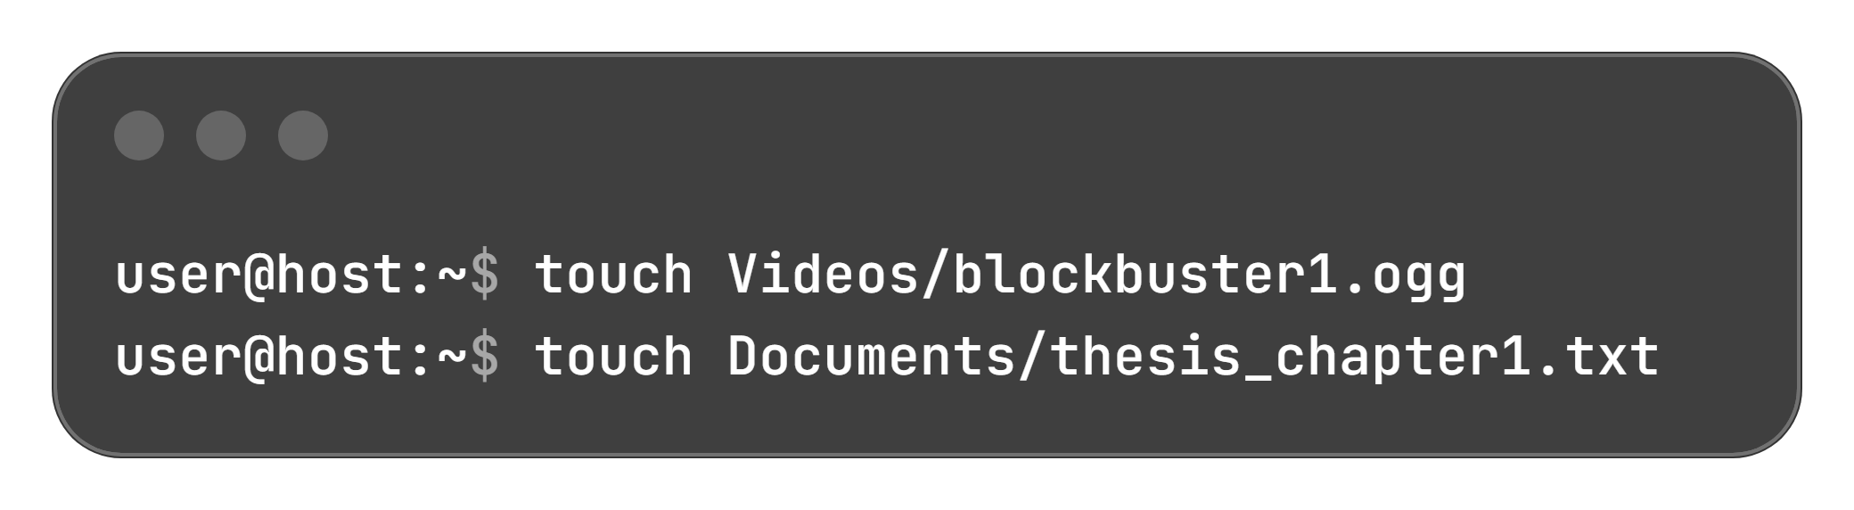
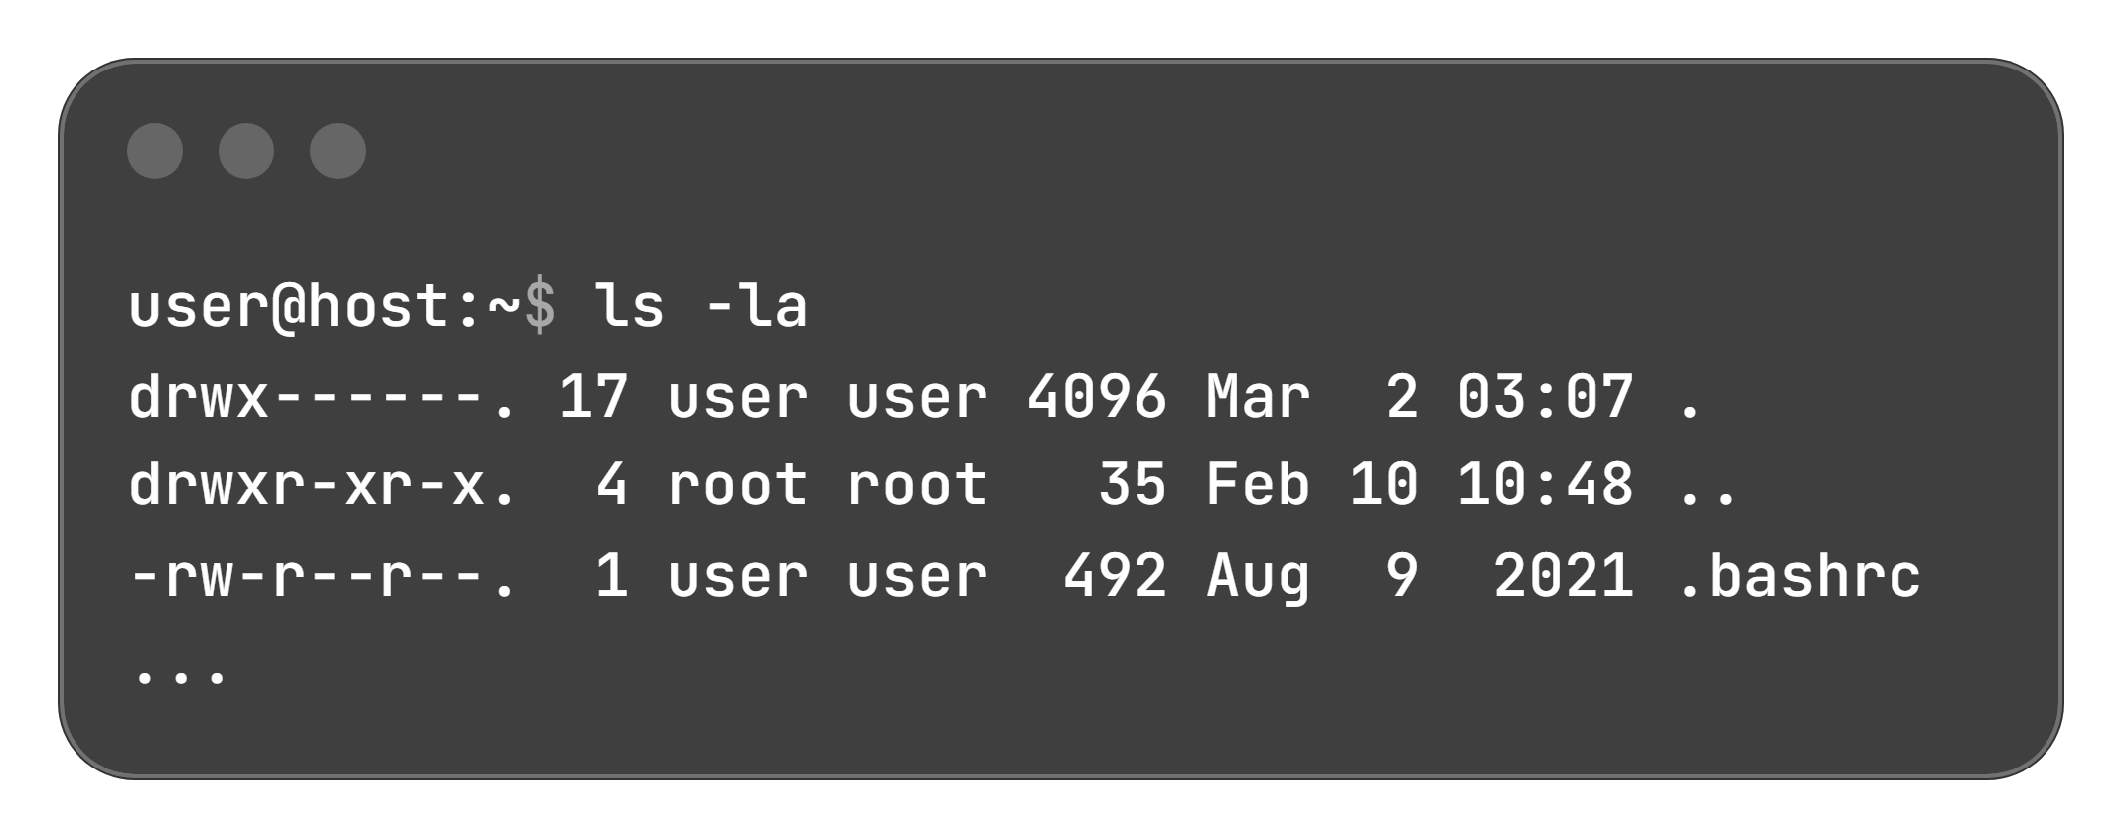
Timestamp Updates, Practice Files & ls Options
Primary Function: Updates the access and modification timestamps of existing files to the current time.
Practice File Creation: If the specified target does not exist, touch creates an empty regular file:
-l (Long Format): Displays file type, permissions, link count, owner, group, byte size, modification timestamp, and name.
-a (All Files): Reveals hidden files along with . and ...
-R (Recursive): Recursively lists all files across nested subdirectories.

Slide 11
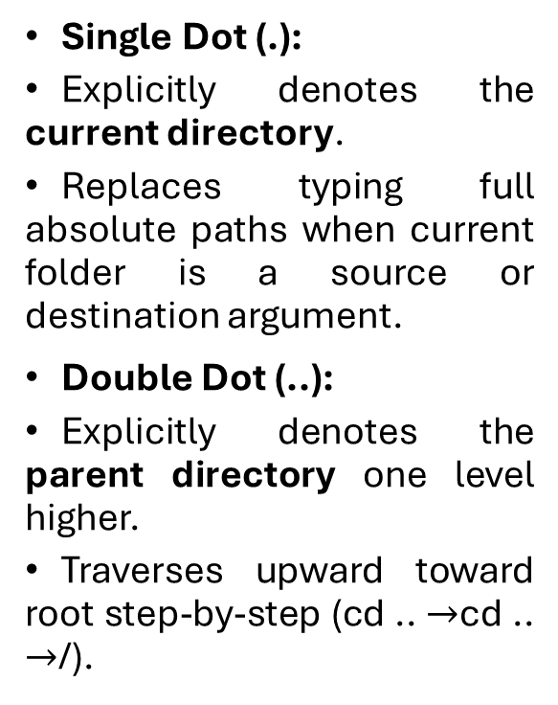
Special Directories & Hidden Files
Single Dot (.):
  Explicitly denotes the current directory.
  Replaces typing full absolute paths when current folder is a source or destination argument.
Double Dot (..):
  Explicitly denotes the parent directory one level higher.
  Traverses upward toward root step-by-step (cd .. $→$cd .. $→$/).
Naming Syntax: Any file or directory starting with a period (e.g., .bashrc, .config) is treated as hidden.
Purpose: Keeps user configuration settings from cluttering interactive home directory views.
Operational Note: Hidden files are not an access control or security measure; true data restriction relies on file permissions.

